Slide 1
Philosophy of Psychiatry: Theoretical Advances and Clinical Implications Dan J. Stein, Kris Nielsen, Anna Hartford, Anne-Marie Gagné-Julien, Shane Glackin, Karl Friston, Mario Maj, Peter Zachar, Awais Aftab World Psychiatry, 2024
Presenter: Stephanie Nelson, Ph.D.
ABPdN Journal Club for December 2024

Slide 2
Understanding Philosophy of Psychiatry
Philosophy of psychiatry explores how we define, understand, and treat mental health conditions
This includes conceptual debates around questions such as:
What is the nature of mental disorders?
How do we best define and diagnose them?
To what degree are diagnoses in the brain vs in the mind?
What causes individuals to experience disorders?
What are the impacts of our diagnoses on individuals?
ABPdN Journal Club December 2024
Notes:
The philosophy of psychiatry examines foundational questions about the nature, classification, and treatment of mental disorders. It integrates insights from philosophy and psychiatry to address conceptual, ethical, and clinical challenges. Central topics include defining mental disorders, understanding the brain-mind relationship, and addressing the role of values in psychiatric practice. Recent developments emphasize pluralism, soft naturalism, and embodied cognition to bridge gaps between evidence-based and values-based care, and those are the ones we’ll focus on today.

Slide 3
Why Read About Philosophy of Psychiatry?
Which scientific problems are prioritized
How problems are studied
How uncertainty is managed
How much evidence is considered sufficient for a diagnosis
How scientific evidence is used to inform decision-making
ABPdN Journal Club December 2024
Notes:
First though, let’s talk about why thinking through these questions is important.

Slide 4
Awareness of your Background Beliefs
Do you think diagnoses are:
Easily Definable………………………………….…..…..……….Fuzzy/Overlapping
Categorical…………………………………………..………………….....Dimensional
Usually Brain-Based…………......…………..Situated in the Person & Context
Defined best by symptoms…………..Or by test results/treatment response
Best defined by clinicians/researchers…………..……Or by lived experience
Natural kinds………………………………………………..………Shaped by society
Similar across individuals…………………...Uniquely shaped by each person
ABPdN Journal Club December 2024
Notes:
How do you see disorders? Does it depend on the disorder? Have you thought through these assumptions, or swallowed them whole from your supervisors and textbooks? Have clients challenged you to consider whether you have assumptions you are unaware of?

Slide 5
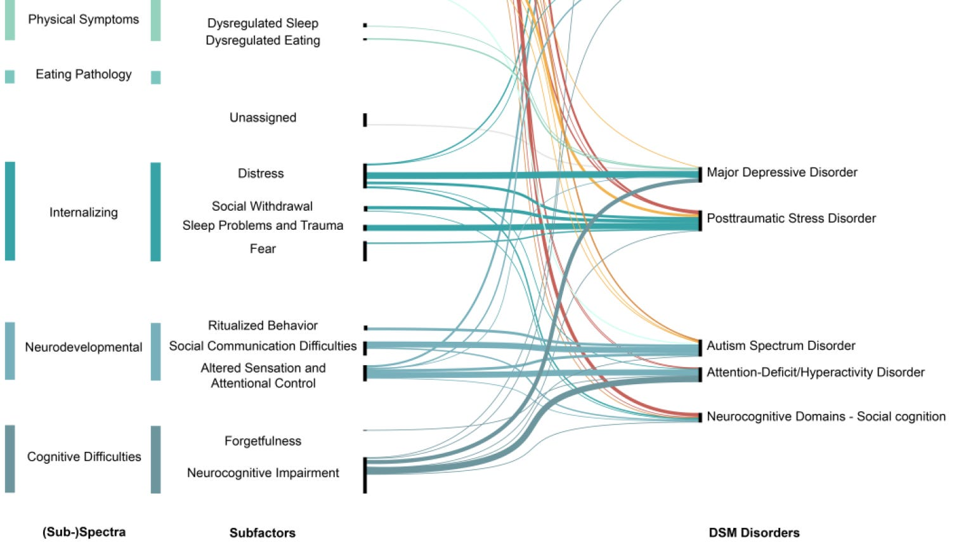
1
D
Depression
5
6
7
8
9
T
Trauma
St
Stressor
Ph
Phobia
Ax
Anxiety
Cy
Cyclothymia
13
14
15
16
17
Dc
Devel Coord
Au
Autism
E
Eating
Im
Impulse
Bi
Bipolar
31
32
33
34
35
LD
Learning
AD
ADHD
Bo
Boarderline
Di
Dissociative
Sz
Schizophrenia
49
50
51
52
52
Image from Forbes et al (2023), Reconstructing Psychopathology: A data-driven reorganization of the symptoms in the DSM
ID
Intellectual
La
Language
Sp
Soc-Prag
S
Selective Mutism
Ca
Catatonia
Notes:
What kind of entities are diagnoses? If we could map the diagnoses in the DSM, would it look more like the periodic table, with discrete entries, each with their own properties, similar to others in the same period (row) or group (column), but also distinctly different? Or would we see a web, or network, or overlapping spectra, or something else entirely?

Slide 6
Natural Kinds:
Psychiatric disease entities can be uncovered through scientific inquiry, and their discrete causal mechanisms can/will be fully understood
Social Kinds:
Created in response to micro- & macroscale cultural factors, resulting in diagnoses that resemble fads (e.g., hysteria, MPD) and are cultural-bound
Fuzzy Sets:
Groupings, dimensions, or spectra with no clear boundaries, multiple overlapping features, resulting in blurry, subjective diagnoses
Practical Kinds:
Created for multiple practical goals like enhancing reliability, facilitating communication, guiding treatment, reducing stigma, and promoting research
Notes:
Philosophers of psychiatry have asked this question as “What kind of entities are diagnoses?” Are they more like natural kinds (periodic table), or fuzzy sets (how the DSM works, where multiple different diagnoses reference the same symptom (e.g., attention; impulsivity; negative affect), there are multiple ways to meet symptom counts, and the distinction between what’s ‘normal’ and what meets criteria is often vague)? Or are they best considered social or practical kinds? Practical kinds is Peter Zachar, from his 2015 article, “Psychiatric disorders: natural kinds made by the world or practical kinds made by us?” For social kinds, refer to Ian Hacking on Looping

Slide 7
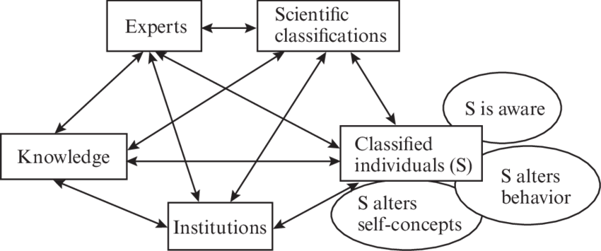
Ian Hacking’s Looping
Image from Tekin (2014), The Missing Self in Hacking’s Looping Effects, MIT Press.

Slide 8
Understanding Philosophy of Psychiatry
What values are we embracing when we make these distinctions? What are diagnoses for:
Reducing harm to others?
Addressing oppression?
Reducing the individual’s suffering?
Supporting psychological flourishing?
Increasing self-understanding?
Advancing science or clinical practice?
ABPdN Journal Club December 2024
Notes:
The philosophy of psychiatry examines foundational questions about the nature, classification, and treatment of mental disorders. It integrates insights from philosophy and psychiatry to address conceptual, ethical, and clinical challenges. Central topics include defining mental disorders, understanding the brain-mind relationship, and addressing the role of values in psychiatric practice. Recent developments emphasize pluralism, soft naturalism, and embodied cognition to bridge gaps between evidence-based and values-based care, and those are the ones we’ll focus on today.

Slide 9
Contrasting Naturalism and Normativism
Mental disorders can be viewed through two contrasting lenses: naturalism and normativism
Naturalism focuses on biological facts, such as brain differences and dysfunctions
Normativism considers social and personal values, such as what society sees as harmful or abnormal
ABPdN Journal Club December 2024
Notes:
Throughout the history of psychology and psychiatry, mental disorders have been conceptualized through two primary lenses: naturalism and normativism. Naturalism views disorders as objective biological dysfunctions, measurable and grounded in scientific methods. In contrast, normativism considers disorders to be inherently value-laden, reflecting societal and cultural judgments about harm and dysfunction.

Slide 10
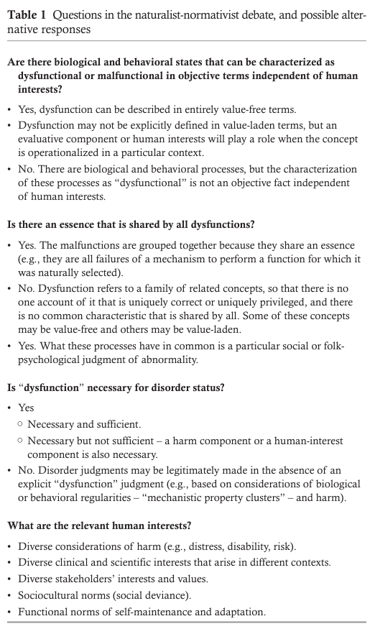
Philosophy of Psychiatry: Core Qs
Psychiatrists and psychologists have long debated these core questions, coming to many different answers
Yet, many clinicians are unaware of their assumptions or struggle to communicate with colleagues who hold different assumptions
Has a client experience ever challenged you to consider whether you have assumptions you are unaware of?

Slide 11
Daisy Metaphor
You can believe in the biological reality of a state while questioning whether it constitutes a disorder
Rachel Cooper’s Weeds vs Daisy metaphor – we can all agree on what a daisy is, while disagreeing about whether daisies are weeds
What are some examples of biological states sometimes thought of as disorders?
Notes:
Text gives example of PMDD Homosexuality used to be in the DSM Oppositional Defiant Disorder might involve brain-based reward processing differences, yet many clinicians are not comfortable diagnosing it Autism and other neurodiverse conditions are increasingly being considered non-pathological differences rather than disorders

Slide 12
A Hybrid Approach: Soft Naturalism
Challenges of Strong Naturalism: Over-reliance on “hard facts” risks ignoring the complexity and value-laden nature of mental health conditions
Challenges of Strong Normativism: Viewing all sociocultural disvalues as potential disorders can lead to problematic relativism
“Soft Naturalism”: Strikes a balance by combining empirical evidence (facts) with societal and personal values
ABPdN Journal Club December 2024
Notes:
Strong naturalism runs the risk of scientism, i.e. over- reliance on what is currently perceived as factual, while strong normativism runs the risk of a relativism where any socioculturally disvalued condition could potentially be considered a disorder. In philosophy, a position that has been termed “soft naturalism” attempts to avoid both scientism and relativism, and to acknowledge the importance of both facts and values in science, , ensuring a nuanced understanding of mental health.

Slide 13
Two Examples of Soft Naturalism
Jerome Wakefield’s
Harmful Dysfunction
Biological or psychological mechanisms dysfunctions when it fails to perform the function selected to perform by evolution
+
Dysfunction is harmful to the individual, with harmfulness judgment being normative/determined by social standards
Example: Grief and stress are harmful but not dysfunctional
Jonathan Tsou’s
Hybrid Model
Mental disorders are biological kinds that exhibit characteristic regularities due to stable sets of interacting biological mechanisms, which allows us to make predictions
+
That cause harmful effects to individuals
Example: Schizophrenia is an identifiable cluster of properties with shared that compromises a person’s capacity to function according to society’s standards
ABPdN Journal Club December 2024

Slide 14
Embracing Explanatory Pluralism
Pluralism is the acknowledgment that no single explanatory model can fully capture the complexity of mental disorders
Multiple frameworks each provides unique insights:
Biological models focus on neurobiological mechanisms, such as genetic predispositions and brain circuit dysfunctions
Psychological models explore temperament, traits, thought patterns, emotions, and behaviors
Social models consider environmental, cultural, and relational factors
ABPdN Journal Club December 2024
Notes:
While soft naturalism highlights the balance between scientific facts and human values in understanding mental health, it also underscores the need for multiple perspectives to fully capture the complexity of disorders. This brings us to explanatory pluralism, which recognizes that no single framework—biological, psychological, or social—can provide a complete understanding. Instead, these perspectives must work together to address the multifaceted nature of mental health

Slide 15
Biopsychosocial Model as an example of Explanatory Pluralism
Biological
Strengths: Provides a comprehensive framework integrating multiple dimensions
Practical challenges: Balancing priorities and navigating interdisciplinary complexities
Social
Psychological
Notes:
The biopsychosocial model exemplifies pluralism by integrating these dimensions. While this model provides a comprehensive framework, its practical application requires balancing competing priorities and managing the complexities of interdisciplinary approaches.

Slide 16
“
Everything simple is false. Everything which is complex is unusable.
-French Poet Paul Valery
”

Slide 17
What is Embodied Cognition?
Explanatory pluralism emphasizes integrating biology, psychology, and social factors – but how do these interact in real time?
Embodied cognition challenges traditional views of the mind as an isolated entity, emphasizing the interconnectedness of brain, body, and environment
Mental processes are not solely located in the brain but emerge from dynamic interactions between an individual and their surroundings
ABPdN Journal Club December 2024
Notes:
While explanatory pluralism emphasizes the need to integrate biological, psychological, and social models to understand mental health, it also invites us to consider how these dimensions interact in real time. This leads us to the concept of embodied cognition, which explores how mental processes are deeply influenced by the body's interactions with its environment. Embodied cognition moves beyond static models, highlighting the dynamic and interconnected nature of the brain, body, and world.

Slide 18
A Holistic View of the Mind: Embodied Cognition
Embodiment:
Highlights the role of the body in shaping cognitive and emotional processes
Embedment:
Situates the mind within a broader environmental context
Enactivism:
Views cognition as an active, ongoing interaction with the environment
ABPdN Journal Club December 2024
Notes:
This perspective is further refined through related concepts:
Embodiment: Highlights the Role of the Body in Shaping Cognitive and Emotional Processes
Physical Sensations in Anxiety: The experience of anxiety is tied to physical sensations like increased heart rate and sweating, showing how the body directly shapes mental states.
Posture and Depression: Slouched posture often observed in depression can influence and perpetuate negative thought patterns, highlighting the connection between body and mind.
Chronic Pain and Mental Health: Chronic pain alters neural processing and is tightly linked to emotional well-being, demonstrating the interdependence of physical and mental processes.
Embedment: Situates the Mind within a Broader Environmental Context
Cultural Influences on Stress: How cultural norms around productivity shape individuals' stress responses and their perceptions of burnout.
Family Dynamics and Psychopathology: Family environments, such as supportive versus critical interactions, directly impact mental health outcomes like depression or resilience.
Urban vs. Rural Mental Health: Differences in access to resources, community engagement, and noise levels highlight how living environments embed individuals in contexts that influence mental health.
Enactivism: Views Cognition as an active, ongoing interaction with the environment
Therapeutic Alliance in Psychiatry: The co-creation of understanding between patient and therapist, where insights emerge from interactive, real-time exchanges.
Behavioral Activation in Depression: Patients actively engaging in meaningful activities to break cycles of inactivity and negative thinking illustrate how cognition is shaped by action.
Navigating Social Anxiety: Overcoming social anxiety through small, lived experiences (e.g., initiating a conversation) showcases how mental states evolve through active participation in the environment.
Embodied cognition has significant clinical implications. It bridges gaps between cognitive neuroscience and phenomenology, allowing clinicians to consider both objective measures and patients' lived experiences. This approach promotes holistic treatments that address biological, psychological, and environmental factors.

Slide 19
“Otto” vs “Inga” Thought Experiment
Inga
Navigates from memory
Processes of navigation take place entirely inside her brain
Otto
Has Alzheimer’s disease so uses a notebook with written directions
Navigation takes place through interaction with tools
The Key Question
Are Otto's notebook and Inga's memory functionally equivalent in this scenario? Clark and Chalmers (1998) argue that they are, because both serve the same purpose: accessing and utilizing information to guide behavior
ABPdN Journal Club December 2024
Notes:
The Otto vs. Inga thought experiment is a famous philosophical scenario introduced by Andy Clark and David Chalmers in their 1998 paper The Extended Mind. It was designed to explore the idea that the mind extends beyond the brain and body to include external tools and resources when they function as part of cognitive processes.
The Thought Experiment
Inga's Memory: Inga is a neurotypical person who wants to visit a museum. She recalls the museum's location from her biological memory and uses this information to navigate there.
Otto's Notebook: Otto has Alzheimer’s disease and relies on a notebook to store information he can no longer reliably recall. When he decides to visit the museum, he consults his notebook to find the address and then navigates to the location.
The Key Question
Are Otto's notebook and Inga's memory functionally equivalent in this scenario? Clark and Chalmers argue that they are because both serve the same purpose: accessing and utilizing information to guide behavior.

Slide 20
Implications for Clinical Practice
Integrating philosophical insights into psychiatry enhances the quality of care by combining evidence-based practices with patient-centered approaches. Key practical considerations:
Values-based care: Recognizing the role of personal and cultural values in shaping treatment decisions
Lived experiences: Incorporating patients’ narratives to better understand their conditions and tailor interventions
Shared decision-making: Involving patients in treatment planning fosters collaboration and aligns care with individual values and goals
ABPdN Journal Club December 2024
Notes:
Practical Implications for Clinical Practice
Integrating philosophical insights into psychiatry enhances the quality of care by combining evidence-based practices with patient-centered approaches. Key practical considerations include:
Values-based care: Recognizing the role of personal and cultural values in shaping treatment decisions.
Lived experiences: Incorporating patients’ narratives to better understand their conditions and tailor interventions.
Interdisciplinary challenges: Navigating the complexities of integrating diverse explanatory models and managing conceptual ambiguities.
Despite these benefits, clinicians must address potential challenges, such as reconciling competing priorities and ensuring that theoretical frameworks translate effectively into practice.

Slide 21
Discussion Questions
When do you consider a behavior or experience to cross the line from being a “difference” to being a “disorder”?
How do you approach situations where diagnostic labels seem to both help and harm your clients?
Have you ever felt torn between diagnosing based on criteria versus addressing the client’s lived experience? How do you balance the two?
How might technology, such as apps or wearable devices, shape the way we think about and define mental health in the future?
What would you change about the current diagnostic frameworks (e.g., DSM, ICD) to make them more useful or accurate?
Notes:
What does the term “mental disorder” mean to you personally, and how might that influence your clinical decisions?How do you navigate the tension between biological explanations for mental health issues and the impact of societal or cultural factors?Can you recall a time when a client’s perspective challenged your understanding of a diagnosis or treatment approach? How did you respond?What role do you think values and cultural norms should play in shaping psychiatric classifications?When do you consider a behavior or experience to cross the line from being a “difference” to being a “disorder”?How do you approach situations where diagnostic labels seem to both help and harm your clients?What strategies have you used to check for your own biases or assumptions when diagnosing or treating clients?How might technology, such as apps or wearable devices, shape the way we think about and define mental health in the future?What would you change about the current diagnostic frameworks (e.g., DSM, ICD) to make them more useful or accurate?Have you ever felt torn between diagnosing based on criteria versus addressing the client’s lived experience? How do you balance the two?

Slide 22
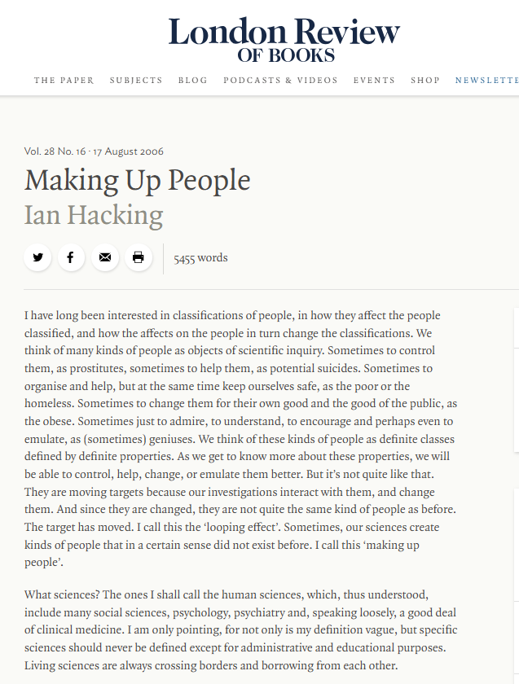
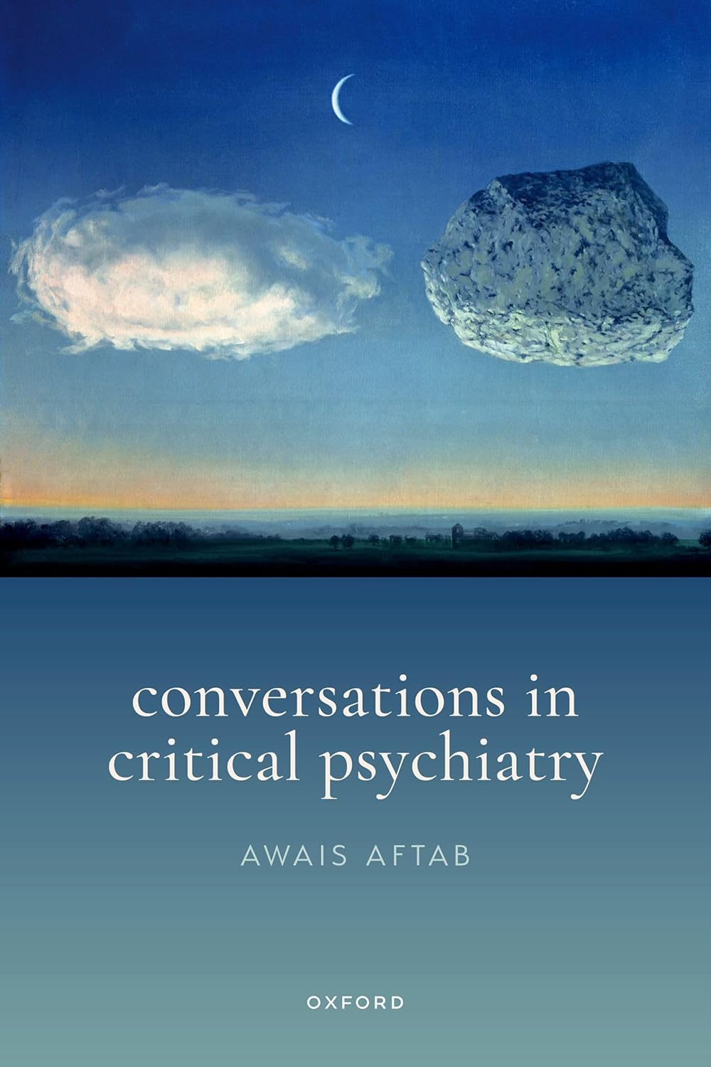
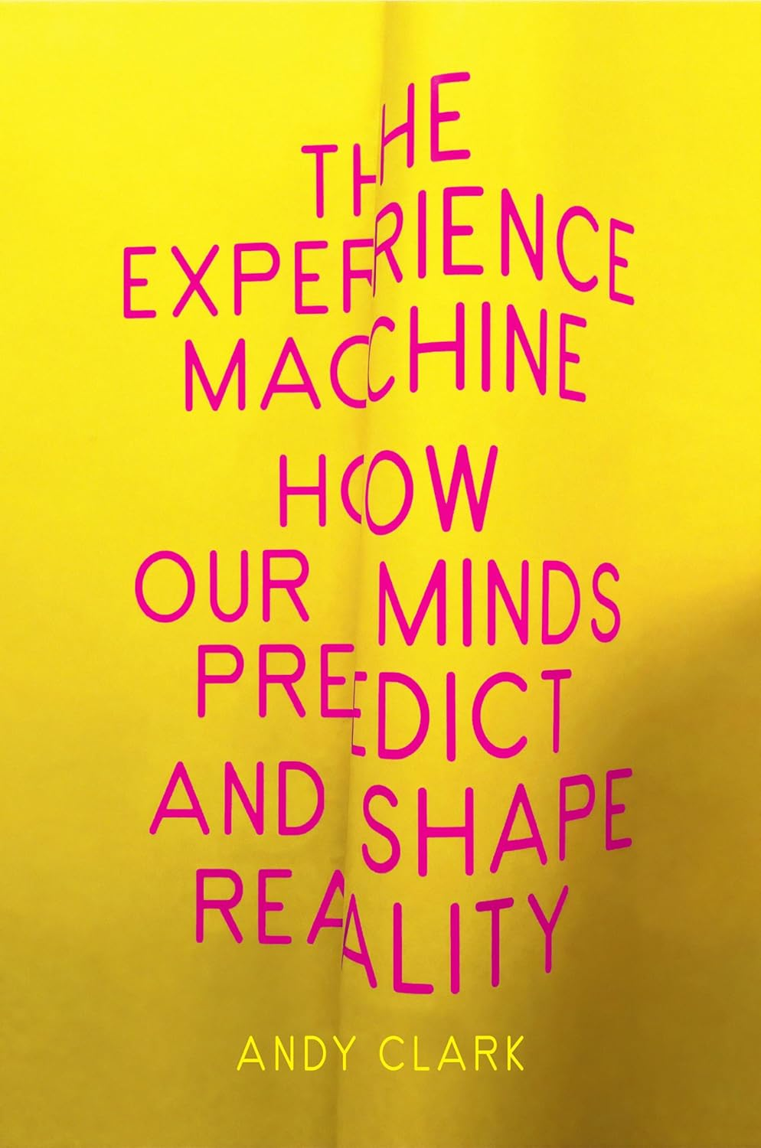
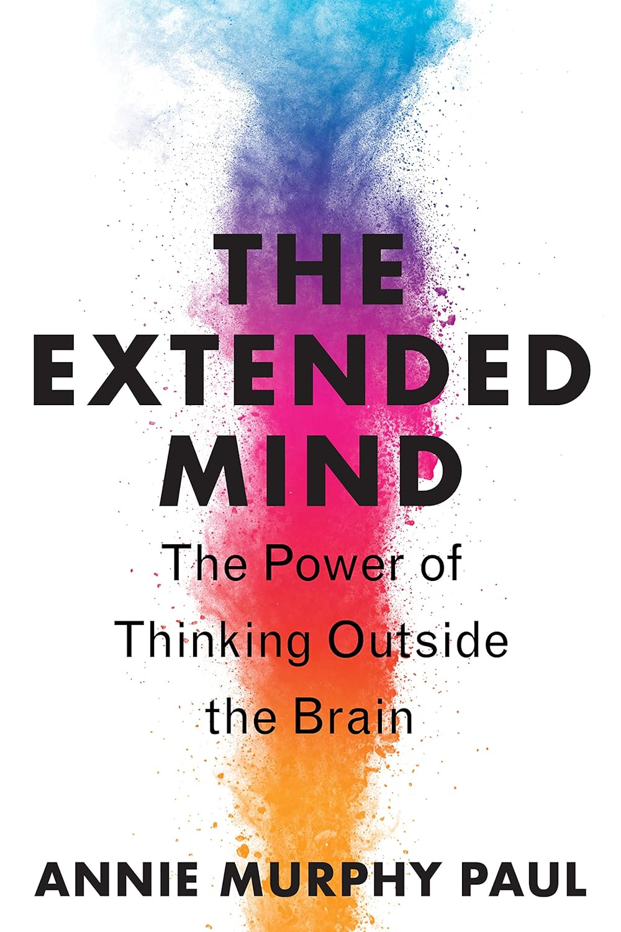
More Info: A Few Recommendations
Philosophy of Psychiatry
Embodied Cognition
Social Construction
ABPdN Journal Club December 2024
Notes:
Conclusion
The philosophy of psychiatry provides valuable tools for addressing foundational questions about mental health. By integrating naturalist and normativist perspectives, embracing pluralism, and adopting embodied cognition, psychiatry moves toward a more holistic and patient-centered practice. These advances underscore the importance of bridging scientific rigor with human values to better understand and treat mental disorders.

